Slide 1
COMP-1597:Digital Media Production
Group 6 – Sharna Patten-Walker, Aaron Watts-Corfe, Dominic McNeil, Jacob Groves

Slide 2
Introduction – Bike Rental Service-Simulator
Concept
The digital artefact is an advertisement for a bike rental service around a park setting. Around the park environment there will be posters that are advertising the bike rental service and can be interacted with. After a set amount of posters are collected and the player wins
Purpose
The general purpose of picking a bike rental service for the intended artefact is targeting various audiences. The enjoyment of riding a bike is the main reason why bike rental maybe of large appeal due to the observation and having the chance to see a lot more than the user would, if they were to run or walk.

Slide 3
Group Members/Roles
Aaron Watts-Corfe - Programmer
Sharna Patten-Walker - Designer
Dominic McNeil - Artist
Jacob Groves - Designer

Slide 4
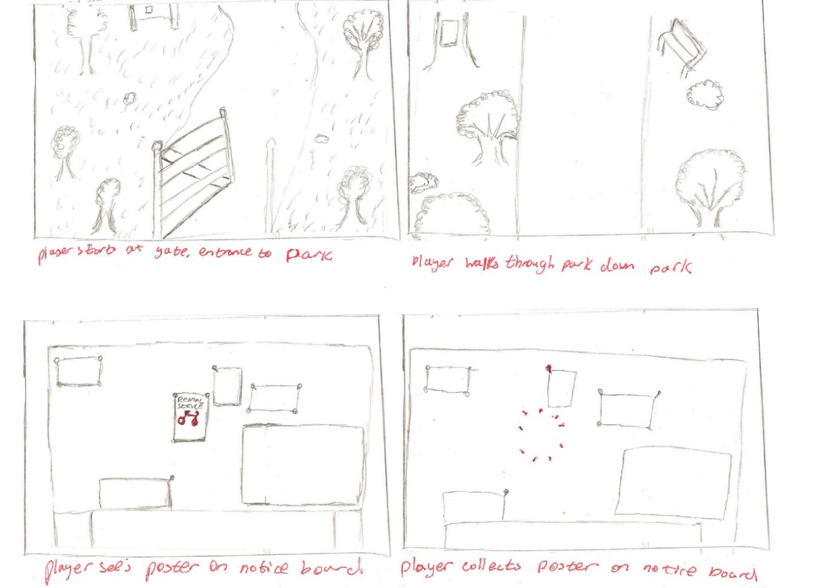
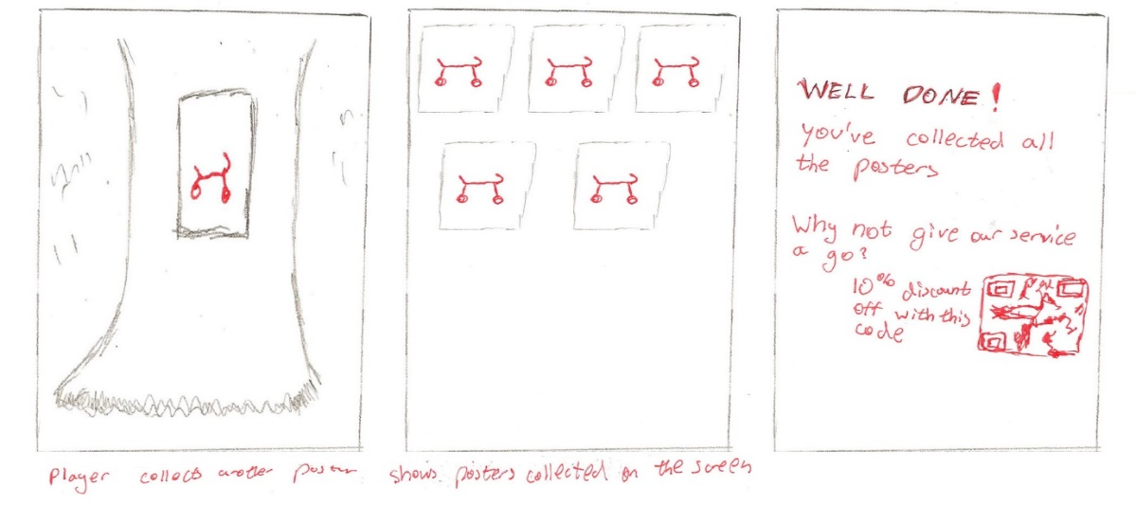
Pre- Production - Storyboard
1.
2.
5.
6.
7.
3.
4.

Slide 5
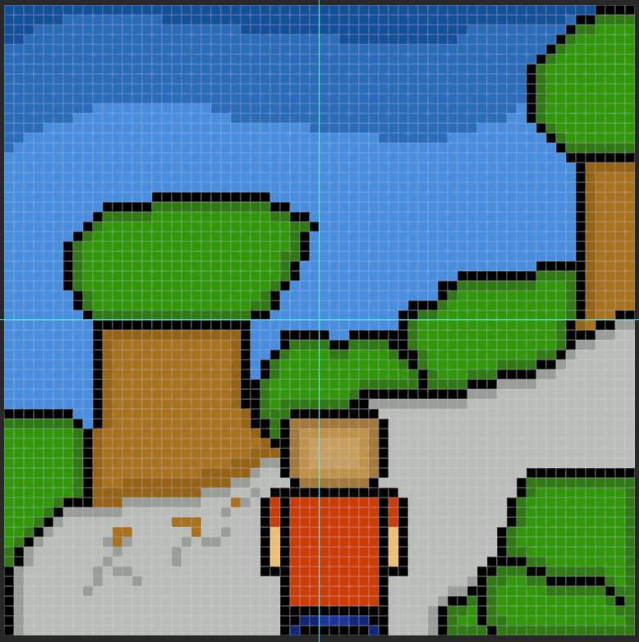
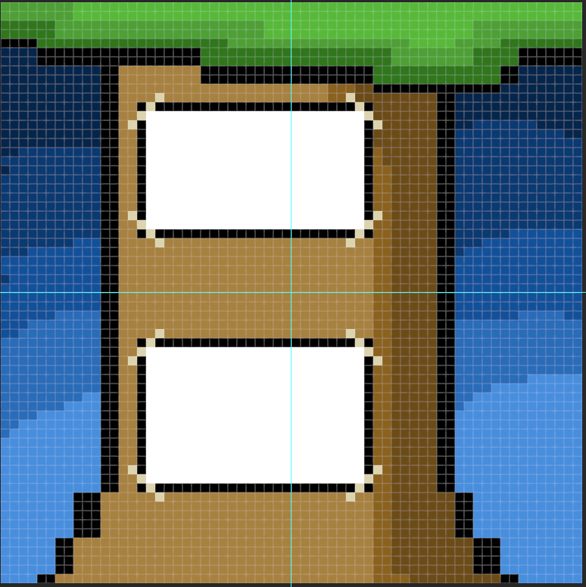

Pre-Production - Designs

Slide 6
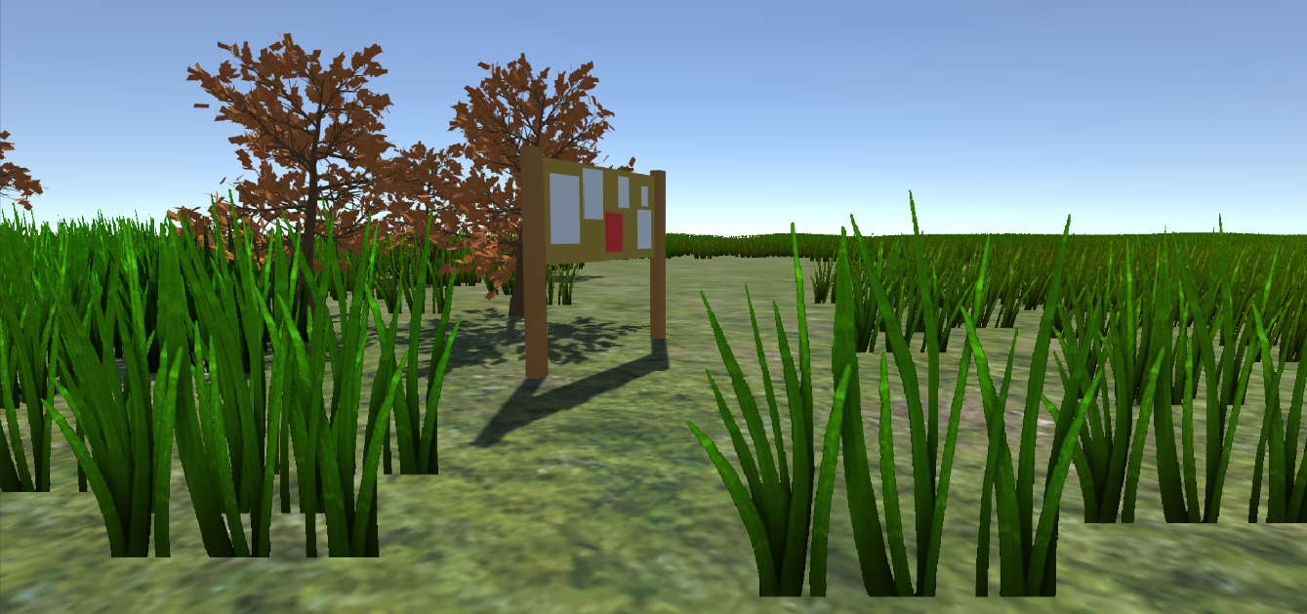
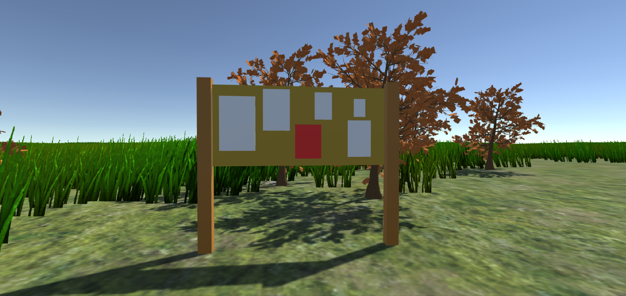
Pre-Production - Prototype

Slide 7
Pre-Production - Requirements
Requirement assessed: The objective of the game should be clear
Requirement assessed: Player should be able to look and move around and interact with environment
Requirement assessed: There should be feedback for the user when interacting with the game
Requirement assessed: Player should be able to pick up/collect posters
Requirement assessed: Players should be able to see/know how many posters they have collected.
Requirement assessed: The game should be evenly paced so the player doesn’t get bored/speed through it.
Requirement assessed: Game should respond once the player has collected every poster
Requirement assessed: The player should be able to begin the game from the main menu. Interact with the main menu and navigate through the options.
Requirement assessed: The game should be visually pleasing
Requirement assessed: The player should be able to quit the game from the main menu.

Slide 8
Production
Development
- Level Design/Modelling
Throughout the digital artefact, the level was adapted to fit the replica of a park. This involved modelling trees, and fences, and positioning the around the park,
- Lights/Lamp Lights
We used dynamic lighting to create shadows and realistic lighting for a day and night cycle.
- UI and UX (Pickup/Main Menu/Win)
We used text in the game so that the player can see the progress made while playing the game such as the poster count.
- Core Mechanics(Movement, Pickup/Collection/Win)
The core mechanics were kept simple so that the user knows what to do and doesn’t get stuck while playing the game. For example the movement for the player and when the player is on the bike.

Slide 9
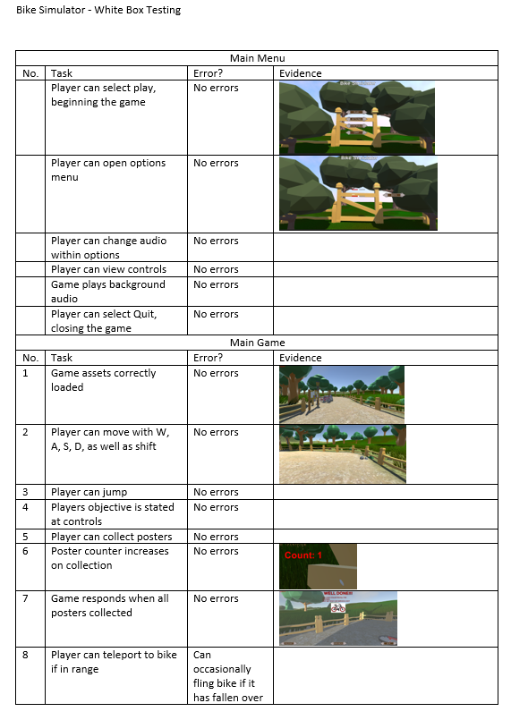
Post Production
White Box-Testing

Slide 10
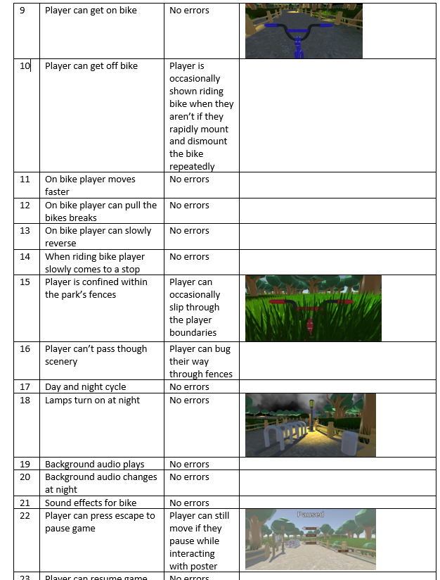
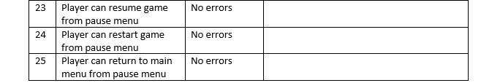
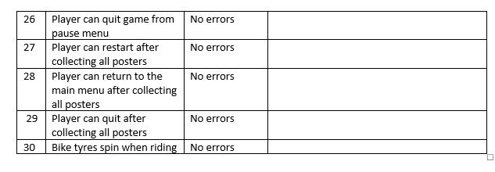

Slide 11
Improvements
Improvements that could have been made to the Digital Artefact.
- Refine controls/gameplay,
- Try fix minor bugs,
- Implement AI, and finally
- More bikes.

Slide 12
Any Questions?

